Slide 1
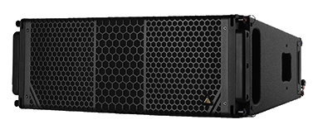
NAME
LINE ARRAY SPEAKER
MODEL
CS10
제조사
ADAMSON
2-WAY, FULL RANGE INTELLIGENT LOUDSPEAKER
Frequency Range (+/- 3dB) : 60 Hz - 18 kHz
Nominal Directivity (-6 dB) H x V : 110° x 10°
Maximum Peak SPL : 141.3 dB
Components LF : 2x ND10-LM 10” Kevlar Neodymium Driver
Components HF : Adamson NH4 4” Diaphragm / 1.5” Exit Compression Driver
Rigging : Slidelock Rigging System
Connections
Power : powerCON TRUE1
Network : 2 x etherCON
Analog : 2 x XLR
Dimension (WxHxD) : 737 x 265/178 x 526mm
Weight : 31kg
Amplification : 2 channel Class-D, 2400 W total output
Input Voltage : 100 - 240 V
Current Draw at 230 V : 0.45 A rms idle, 1.6 A rms long-term, 10 A max peak
Processing : Onboard / Proprietary

