Slide 1
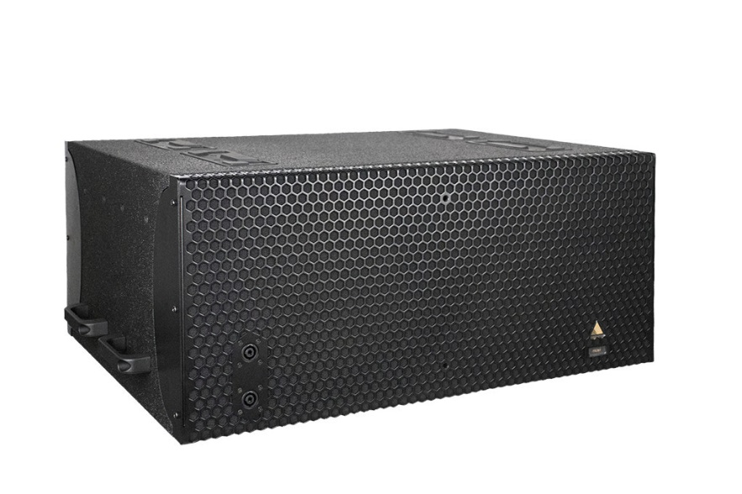
NAME
SUBWOOFER SPEAKER
MODEL
IS213
제조사
ADAMSON
Subwoofer
Frequency Range (+/- 3dB) : 33 Hz - 100 Hz
Maximum Peak SPL : 137 dB
Components LF : 2x SD13-S 13” Kevlar® Neodymium Driver
Nominal Impedance LF : 4 Ω (2x 8 Ω)
Power Handling (AES / Peak) LF : 1600 / 6400 W
Rigging : N/A
Connection : 4x Speakon™ NL4 (2x Front 2+/2-, 2x Rear (1+/1-), or
Barrier Strips
Dimension (WxHxD) : 813 x 349 x 629mm
Weight : 36kg
Colour : Black & White (Standard), RAL Colours (On Demand)
Supported Processing : Lake

