Slide 1
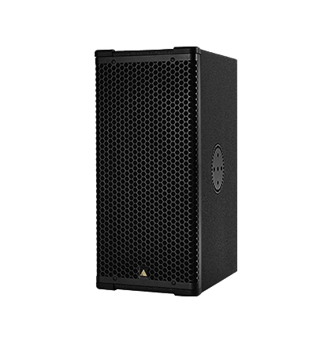
NAME
LINE ARRAY SPEAKER
MODEL
S7p
제조사
ADAMSON
2-WAY, FULL RANGE POINT CABINET
Frequency Range (+/- 3dB) : 80 Hz - 18 kHz
Nominal Directivity (-6 dB) H x V : 70° x 40° or 100° x 50° Rotatable
Maximum Peak SPL : 136.5 dB (135dB in passive)
Components LF : 2x ND7-LM16 7” Kevlar Neodymium Driver
Components HF : NH3-8 3" Diaphragm / 1.4" Exit Compression Driver
Nominal Impedance LF : 8 Ω (2 x 16 Ω in parallel)
Nominal Impedance HF : 8 Ω
Nominal Impedance Passive : 6 Ω
Power Handling (AES / Peak) LF : 500 / 2000 W
Power Handling (AES / Peak) HF : 110 / 440 W
Power Handling (AES / Peak) passive : 500 / 2000 W
Rigging : Integrated Rigging System
Built-in Polemount Socket
Connection : 2x Speakon™ NL4
Dimension (WxHxD) : 527 x 249 x 365mm
Weight : 17kg
Processing : Lake (2-way Module, or 1-way module in passive)

