Slide 1
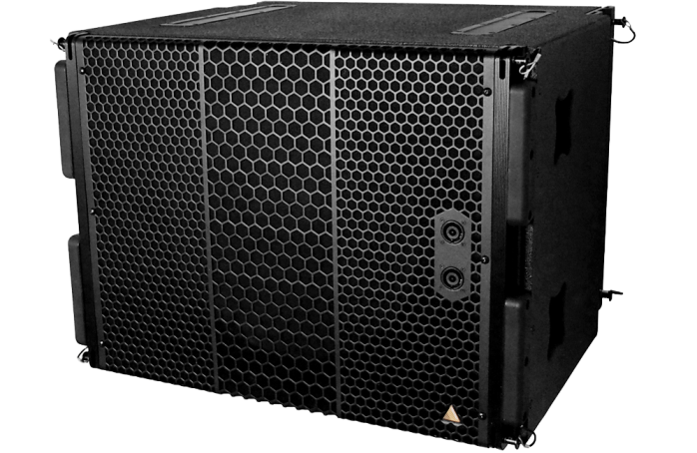
NAME
LINE ARRAY SUBWOOFER SP.
MODEL
S119
제조사
ADAMSON
SUBWOOFER
Frequency Range(±3dB) : 30 ~ 80Hz
Maximum Peak SPL : 138dB
Components LF : ND19 19” Kevlar Neodymium Driver
Nominal Impedance LF : 8Ω
Power Handling (AES / Peak) LF : 1,200 / 4,800w
Rigging : Integrated Rigging System,
: Built-in M20 Thread
Connection : 5x Speakon™ NL8: 2x Front (Pins 2 +/-), 2x Rear Parallel (Pins 1 +/-) and 1x Rear Output (Pin 2 to 1)1x Speakon™ NL4: 1x Rear Output Link for Tops (3+/-,4+/-)
Dimension (WxHxD) : 742 x 543.5 x 630mm
Weigh : 47kg
Supported Processing : Lake

