Slide 1
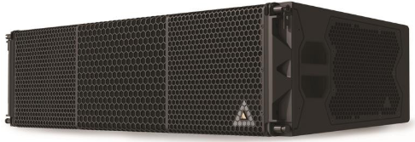
NAME
LINE ARRAY LOUDSPEAKER
MODEL
VGt
제조사
ADAMSON
3-WAY POWERD LINE SOURCE
Frequency Range : (+/- 3dB) 50 Hz - 20 kHz
Nominal Directivity : (-6 dB) H x V 90° x 6°
Maximum Peak SPL* : 151 dB
LF Component : 2x ND13-S 13” Kevlar Neodymium Driver
Directional Component : 2x ND10-LM 10” Kevlar Neodymium Driver
MF Component : 2x M140 Kevlar Compression Driver
HF Component : 2x 3” Compression Driver
Rigging : Autolock™ Rigging
Connection : 2x etherCON™ - passive continuity when powerless, Analog XLR3 in & thru, powerCON TRUE1 TOP in & thru
Height Front (mm / in) : 338 / 13.3
Height Back (mm / in) : 286 / 11.25
Width (mm / in) : 1306 / 51.4
Depth (mm / in) : 562 / 22.1
Weight (kg / lbs) : 85 / 188
Colour : Black & White (Standard), RAL Colours (On Demand)
Amplification : 5 channel Onboard Class-D, SMPS
Processing : Onboard, controllable through proprietary software

