Slide 1
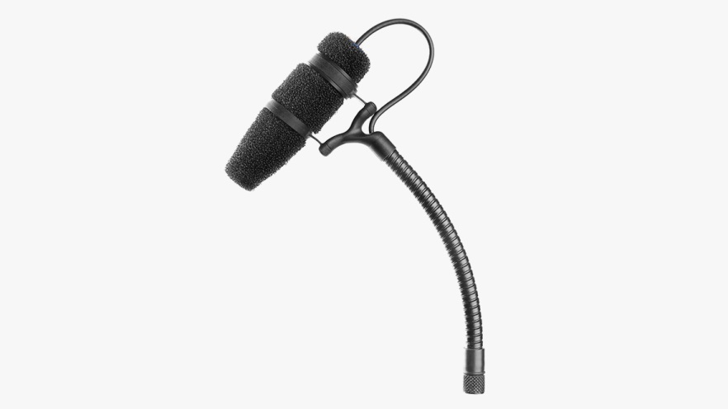
NAME
GOOSENECK MICROPHONE
MODEL
4097
제조사
DPA
Micro Shotgun Microphone
Directional pattern : Supercardioid
Principle of operation : Pressure gradient
Cartridge type : Pre-polarized condenser
Frequency response : 20 Hz - 20 kHz
Effective frequency range ±2 dB, at 20 cm (7.9 in) : 80 Hz - 15 kHz with 2 dB soft boost at 10-12 kHz
Sensitivity, nominal, ±3 dB at 1 kHz : 16 mV/Pa; -36 dB re. 1 V/Pa
Distortion, THD < 1% : 130 dB SPL RMS, 133 dB SPL peak
Dynamic range : Typ. 110 dB
Max. SPL, THD 10% : 135 dB SPL peak
Rated output impedance
From MicroDot : 30 - 40 Ω.
From DAD4099-BC XLR Adapter : 100 Ω
Connector : MicroDot
Color : Black
Weight : 10 g (0.35 oz)
Microphone length : 10.4 cm (4 in)

